Slide 1

라자루스 조직 | Lazarus Group: From DPRK to DIGITAL ASSETS
North Korean APTs & The Digital Assets Sector
Han O’Connor, Junior Security Analyst
Notes:
Good afternoon everyone,
In this talk, I am going to give an overview of the APT groups that have been linked to North Korea, especially the Lazarus cluster, as well as a breakdown of past campaigns and operations attributed to the group, and a slightly more detailed overview of two recent campaigns, RustBucket and KANDYKORN.

Slide 2
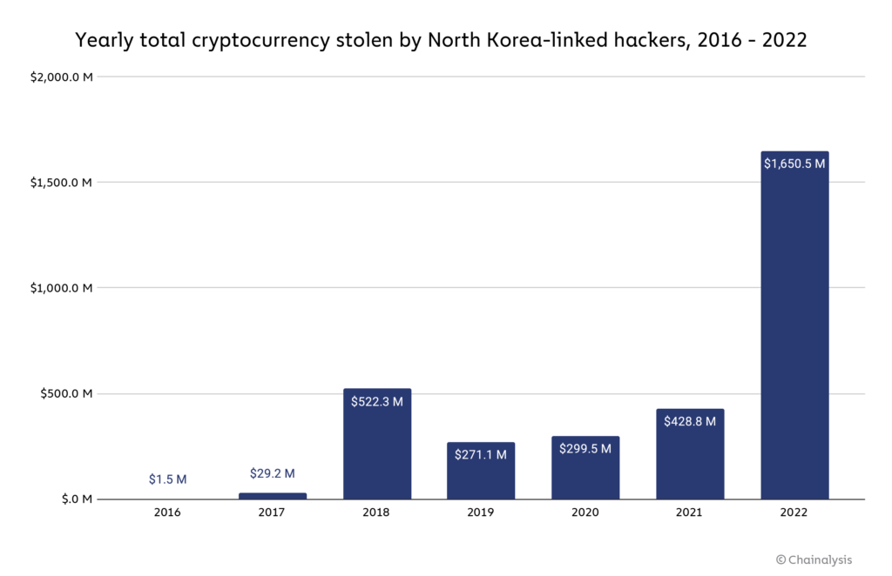
Context
$3 billion theft of digital assets since 2017.
$1.7 billion in 2022
$1.1 billion theft from DeFi hacks
라자루스 조직 - Lazarus Group
Chainalysis (2023), The 2023 Crypto Crime Report
Notes:
A recent report estimated that threat actors linked to the Democratic People’s Republic of Korea (DPRK), had successfully acquired approximately $3 billion USD in stolen digital assets since the commencement of their APTs’ cryptocurrency-related operations in 2017. $1.7 billion of this figure was acquired 2022 alone, with $1.1 billion stemming from the compromise of decentralised finance, or DeFi, platforms (Chainalysis, 2023). The consensus among security researchers, both public and private sector, is that the revenue from cybercrime has become a significant source of income for the DPRK. For context, the total revenue from exports for the DPRK was just $142 million.
The Lazarus group, probably the most prolific and well-known APT linked to the DRPK’s regime, was designated as a ‘controlled entity of the Government of North Korea’ by the US Treasury Department’s Office of Foreign Assets Control (or OFAC) in 2019. The Lazarus Group was also added to the list of crypto-related entities sanctioned by OFAC in 2022, due to their crypto-related cyber operations and thefts.
Just a brief note on the USD values used: it is difficult to confirm the exact US dollar value of each theft due to the volatility of digital assets, so any conversions to US dollar values are based on the value at the time of each event or report, rather than the value today. Although for anyone interested, the current market value of 1 BTC is approximately £33,000 GBP or $42,000 USD, so some of the figures given for earlier thefts would likely now be significantly higher today if the funds were retained.

Slide 3
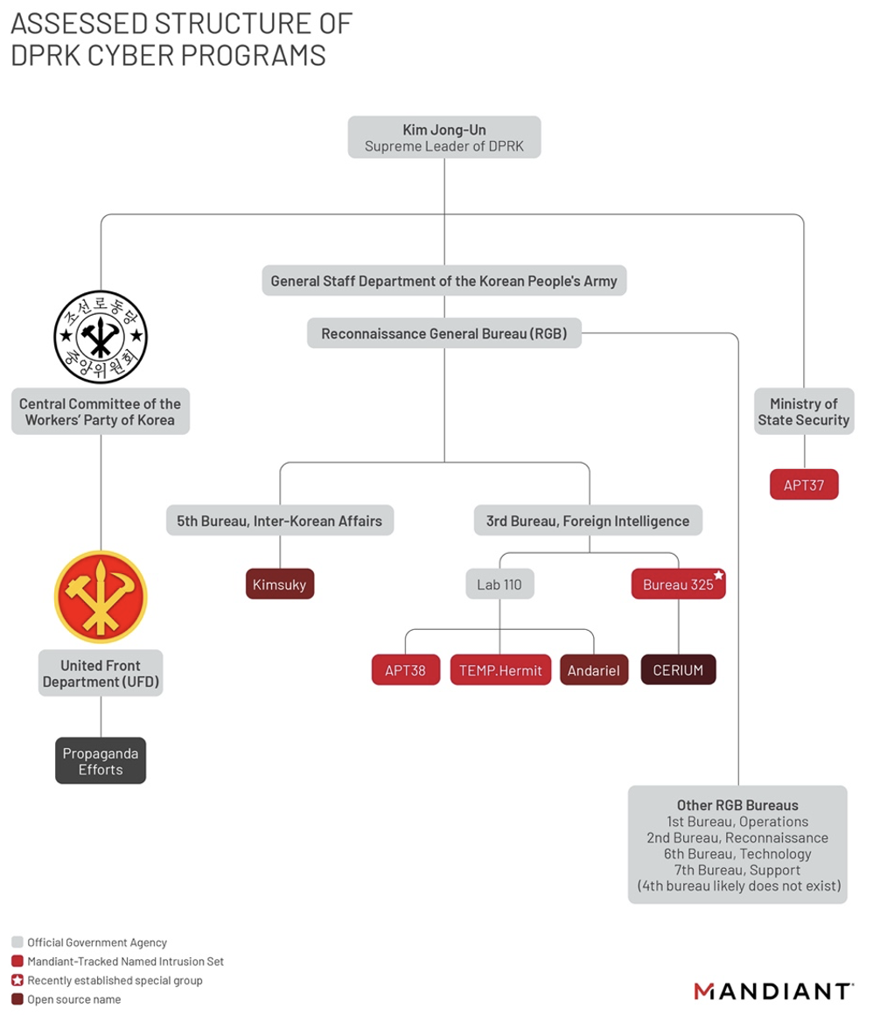
DPRK CYBER PROGRAMME STRUCTURE
라자루스 조직 | Lazarus Group
APT38
3rd Bureau – Foreign Intelligence
BlueNoroff
Notes:
Just to give an indication of the sophistication of the DPRK’s cyber programme, the Lazarus Group (also known as APT38) are thought to be just one of several groups within the government’s cyber operations structure. The APT group is thought to sit under North Koreas’ intelligence service the Reconnaissance General Bureau (RGB) within their 3rd Bureau, focused on Foreign Intelligence, according to recent research by Mandiant (2022). It is worth noting, however, that the Lazarus Group is sometimes used within the mainstream media as an umbrella term referring to all, or any, of the 3rd Bureau’s cyber operations groups. Whereas the Kimsuky (kim-zu-kee) APT primarily targets South Korean organisations with a focus on government and critical national infrastructure, primarily for intelligence and espionage purposes. The Ministry of State Security-linked APT37 group is also thought to predominantly conduct intelligence operations, with a focus on other nations within Asia and the Middle East region.
Due to time constraints, this talk will focus primarily on the Lazarus Group, as well as BlueNoroff a closely-related APT group which is currently thought to be a sub-group of the Lazarus Group, due to the focus of their cyber operations against the global financial sector, and especially digital assets services,. All incidents and operations referenced have been attributed to the Lazarus Group or BlueNoroff unless stated otherwise.

Slide 4
Key FINTECH Incidents Timeline: BackGround
March 2013 Dark Seoul malware
Feb 2016 Bangladesh Central Bank Cyber Heist
Feb 2017 First Known Cryptocurrency Exchange compromise: Bithumb
April 2017 Yapizon CryptoExchange Compromise
April 2017 APT38/Andariel Monero Mining Identified
May 2017 WannaCry Ransomware Attack (Bitcoin Ransom & Laundering)
April 2018 Gate.io compromise (peel chaining used to launder)
2017-2018 Marine Chain Token ICO scam
2018-2020 AppleJeus - Trojanised digital asset wallets and trading apps
Notes:
Alleged state-sponsored actors linked to the DPRK have been active from at least 2009, with earlier operations focused primarily on censorship and hacktivism, having launched several high-profile campaigns against US and South Korean government and financial institutions. However, the aim of these earlier operations targeting financial institutions, such as the 2013 cyberattacks on South Korean banks utilising Dark Seoul malware, appears to have been cyber-espionage and disruption.
Since 2016, the DPRK’s cyber operations have shifted to focus on the global financial sector, and especially digital assets, with their motivations pivoting toward cybercrime as a significant source of income and revenue generation in the face of crippling economic sanctions from the international community. Revenue generated from malicious cyber operations is also thought to have helped finance the nation’s nuclear and ballistic missile programmes in recent years (US Department of the Treasury, 2023).
The first known operation specifically targeting digital assets firms was the compromise of wallets for the South Korean cryptocurrency exchange Bithumb, followed by Yapizon and Youbit. The DPRK were also discovered to be mining cryptocurrency, such as Bitcoin and Monero, from 2017, with DPRK-affiliated APT Group Andariel even using compromised servers for mining Monero (Recorded Future, 2023). DPRK actors were also alleged to have developed and marketed the Marine Chain Token and related initial coin offering (ICO) scam throughout 2018 which promised to enable investors to purchase fractional ownership interests in shipping vessels, supported by a blockchain, but instead allowed the DPRK to ‘secretly obtain funds from investors, control interests in marine shipping vessels, and evade U.S. sanctions’ (DoJ, 2021).
Spearphishing activity against South Korean cryptocurrency exchanges increasing throughout 2017 and 2018, culminating in the compromise of the China-based Gate.io cryptocurrency exchange via a phishing campaign in April 2018. Once they gained access to the exchange, the group stole almost $230 million in BTC, ETH, LTC and DOGE; they then leveraged the peel chaining tactic to successfully launder $100 million through a serious of smaller transactions (DHS, 2023). The group also continued to target traditional financial institutions using the SWIFT money transfer system throughout this period with operations targeting banks in India, Pakistan, Vietnam, Mexico, Chile, Taiwan and Malta. During this period, the group were also linked to the development of Trojanised digital asset wallets and trading apps, including Celas Trade Pro, JMT Trading, Union Crypto Durusio, Kupay Wallet, CoinGoTrade and Ants2Whale, using the AppleJeus malware to compromise users’ wallets.

Slide 5

Key FINTECH Incidents Timeline: RECENT INCIDENTS
Sept 2020 KuCoin Hack (first known use of mixers)
March 2022 Axie Infinity Ronin Bridge Attack - $625 million ETH & USDC theft
June 2022 Harmony Horizon Bridge Exploit - $100 million theft
June 2023 Atomic Wallet Compromise - $100 million theft from c. 5,550 wallets
2023 - RustBucket/KADYKORN
Notes:
Around 2020, the increased sophistication of the Lazarus Group’s crypto-related cyber operations became apparent with their successful compromise of the popular Singapore-based cryptocurrency exchange KuCoin. Although the initial access method has not been publicly disclosed, it was confirmed that the group successfully obtained the private keys to all the exchanges hot (or online) storage wallets, compromising approximate $281 million of the exchange's funds (Coindesk, 2020). This was also the first known incidence of the group using mixer services Tornado Cash, Wasabi Wallet and ChipMixer to launder the stolen assets, before moving the funds onto decentralised finance platforms as an additional step to evade detection (DHS, 2023).
In June 2022. the Ronin bridge associated with popular game Axie Infinity was compromised in an operation attributed to the Lazarus Group. The operation compromise five of the nice validator nodes, gaining the five-signature majority required to confirm and validate forged withdrawals, enabling the theft of an estimated $625 million USD worth of ETH and USDC tokens at the time (making this the largest known crypto-related heist). The initial access was reportedly obtained by advanced spear-phishing campaigns, targeting developers of the game within fake job offers, allowing them to compromise a senior blockchain engineer’s device before gaining access to four of the developer-run nodes used to validate transactions on the Ethereum sidechain.
In June 2022, the Harmony Horizon cross-chain bridge for Etherueum suffered a breach attributed to the Lazarus Group/APT38 by the FBI. The group were able to compromise a multi-signature wallet, enabling the transfer of $100 million worth of ETH to wallets linked to the APT group.
In June 2023, approximately $100 million USD worth of digital assets were stolen when a noncustodial decentralised Atomic Wallet was compromised. Although the root cause has not been disclosed, an estimate 5,500 wallets were compromised during the operation.
Finally, throughout 2023, the Lazurus sub-group Blueoroff has been linked to campaigns using macOS malware RustBucket and KANDYKORN, targeting blockchain developers and engineers via popular platforms like Discord.

Slide 6
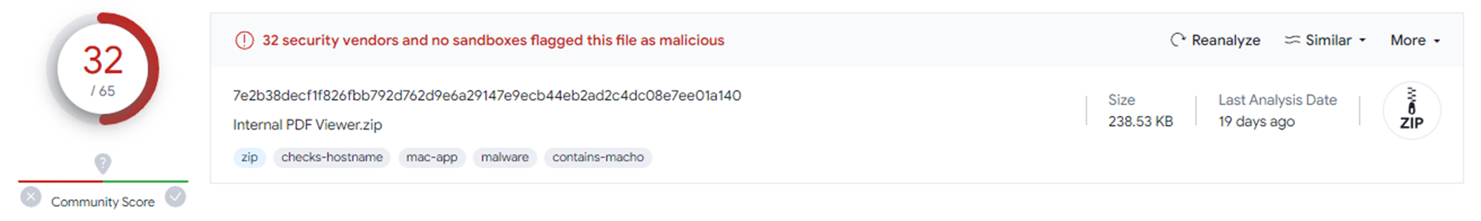
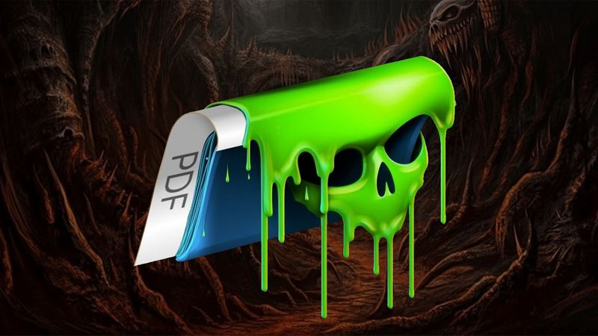
RUSTBUCKET
macOS malware family leveraging modified PDF Reader
Stage 1 SwiftLoader – fake backdoored PDF Reader (AppleScript file) to retrieve stage 2 payload)
Stage 2 C2 Communication – Objective-C PDF Viewer & lure document: InvestmentStrategy(Protected).pdf
Stage 3 Trojan – Rust Mach-O executable to run system recon
Jamf (2023), BlueNoroff APT group targets macOS with ‘RustBucket’ Malware
Notes:
RustBucket is a macOS malware family that has been attributed to BlueNoroff to security researchers. Windows variants of RustBucket were also reportedly first observed in the wild in late December 2022 (Kaspersky, 2022).
RustBucket communicates with C2 servers to download and executes various payloads (Jamf, 2023):
Stage 1, which has been dubbed SwiftLoader is comprised of a fake backdoored PDF Reader, which is actually an AppleScript file used to retrieve the stage 2 payload.
Stage 2 uses C2 Communication to download an Objective-C PDF Viewer, and a lure document, the most prominent being a file called ‘InvestmentStrategy(Protected).pdf.’ This component actually does have basic PDF viewing capabilities, enabling the target user to open the lure file, the contents of which have been spoofed from a legitimate small venture capital firm, and inadvertently execute the malicious embedded code. This tiggers a POST request to a C2 server, to retrieve and execute the stage 3 payload.
The Stage 3 component is another ad-hoc signed trojan, an executable that has the capabilities to run system reconnaissance comments, collecting data about the compromised host.
RustBucket is not the first use of modified PDFreaders attributed to the group (this was first observed in the 2020 DreamJob campaign attributed to the Lazarus cluster), but it does appear to be the first known campaign to specifically target macOS users with this technique (Sekoia, 2023).
Ref: https://www.jamf.com/blog/bluenoroff-apt-targets-macos-rustbucket-malware/
Ref: https://thehackernews.com/2023/04/lazarus-subgroup-targeting-apple.html
Ref: https://blog.sekoia.io/bluenoroffs-rustbucket-campaign/

Slide 7
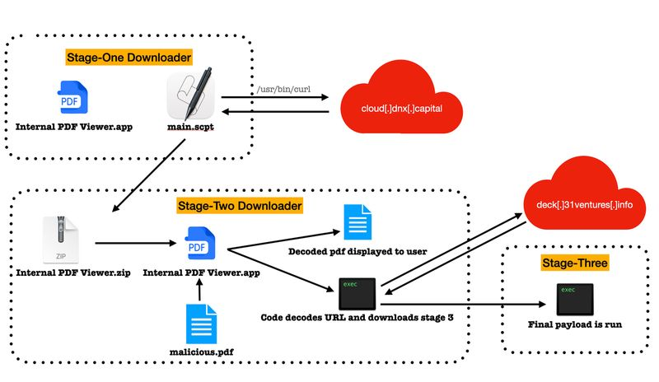
RUSTBUCKET
Jamf (2023), BlueNoroff APT group targets macOS with ‘RustBucket’ Malware
Notes:
Researchers at Jamf, who were among the first to discover and report on the macOS malware variant, released a detailed overview of the workflow (seen on the slide), as well as known indicators of compromise. The report is in the references section at the end of the slidedeck, if anyone would like to read about the malware variant in more depth.
Ref: https://www.jamf.com/blog/bluenoroff-apt-targets-macos-rustbucket-malware/

Slide 8
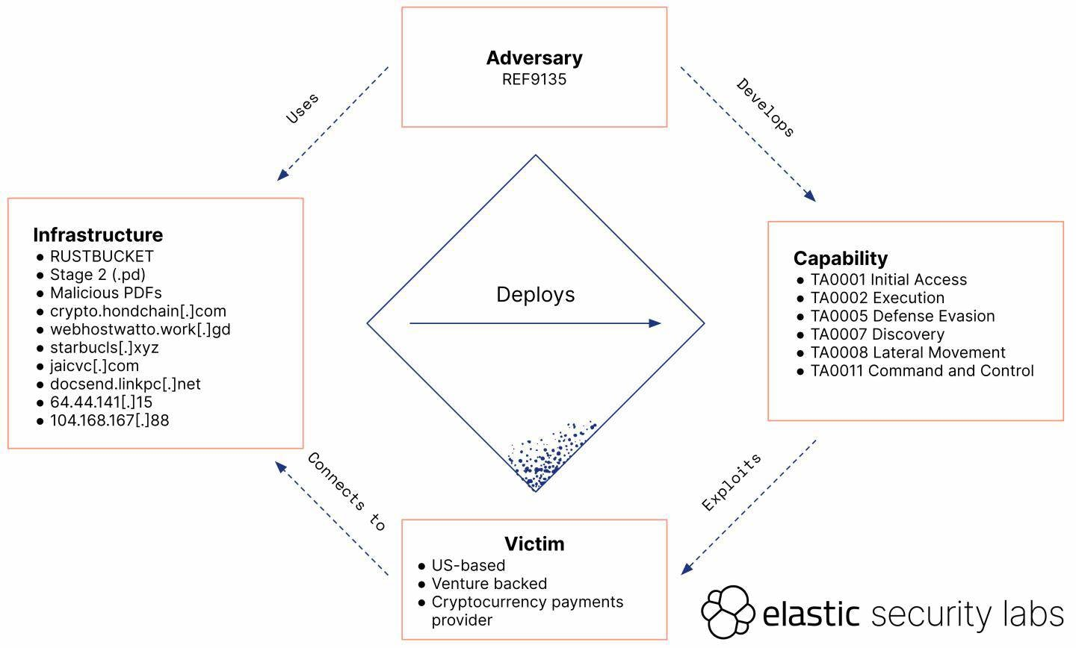
RUSTBUCKET
Elastic (2023), DPRK Strike Using a New Variant of RUSTBUCKET
Notes:
Elastic Security have also researched the malware family and newer variants in details. Their report, including a Diamond model to describe the high-level relationships between the known RustBucket incidents is also listed in the references on the slide deck.
Ref: https://www.elastic.co/security-labs/DPRK-strikes-using-a-new-variant-of-rustbucket

Slide 9

KANDYKORN
Blockchain Engineers targeted via Discord
Stage 0 (Initial Compromise) - Watcher.py
Stage 1 (Dropper) - testSpeed.py and FinderTools
Stage 2 (Payload) - .sld and .log - SUGARLOADER
Stage 3 (Loader)- Discord (fake) – HLOADER
Stage 4 (Payload) - KANDYKORN
Bleeping Computer (2023), Source
Notes:
The KANDYKORN macOS malware variant has recently been observed in the wild targeting cryptocurrency exchange blockchain engineers via the widely-used Discord app.
KANDYKORN was first observed in the wild in November 2023 by security researchers at Elastic Security Labs.
The threat actors, alleged to be BlueNoroff, have reportedly lured blockchain engineers with a Python application to gain initial access to the target environment.
Elastic have described the primary malware execution flow as follows:
Stage 0 (Initial Compromise) is achieved with Python file Watcher.py designed and advertised as a crypto arbitrage bot.
Watcher.py then imports the Stage 1 dropper testSpeed.py which ‘establishes an outbound network connection and fetches another Python file from a Google Drive URL, named FinderTools.’
The Stage 2 payload involves the execution of an obfuscated binary dubbed SUGARLOADER (.sld and .log ). This then connects to a C” server to retrieve the final stage payloads
The Stage 3 loader HLOADER ia a payload designed to masquerade as the legitimate Discord application. The macOS binary code-signing technique used for this payload, was used to support the attribution to Lkazarus and BlueNoroff owing to similarities observed in previous campaigns. HLOADER is a self-signed binary written in Swift, used to ‘execute both the legitimate Discord bundle and the .log payload’, which is used to execute binary files directly in memory without writing to disk.
Finally, the Stage 4 payload, which has been dubbed KANDYKORN has the capabilities to access and exfiltrate data from the compromised host, using reflective loading, a direct-memory method of execution in order to evade detection.

Slide 10
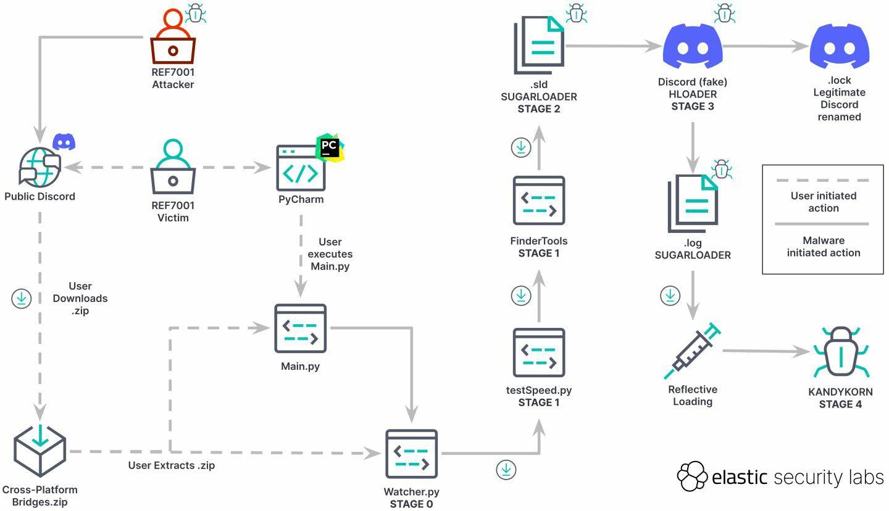
KANDYKORN
Elastic (2023), Elastic catches DPRK passing out KANDYKORN
Notes:
The original Elastic labs report contains a detailed analysis of the execution flow, as well as known indicator of compromise. The report is also included in the references section in case anyone would like to read a more detailed description of the execution flow.
Ref: https://www.elastic.co/security-labs/elastic-catches-dprk-passing-out-kandykorn

Slide 11
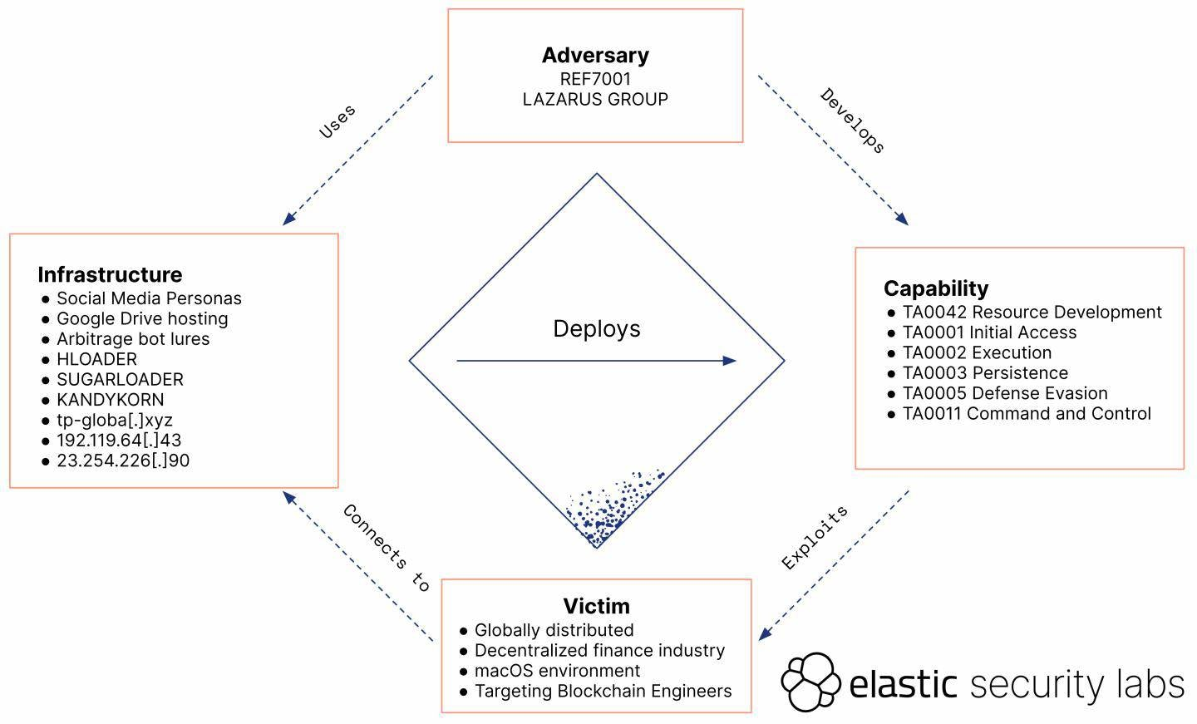
KANDYKORN
Elastic (2023), Elastic catches DPRK passing out KANDYKORN
Notes:
Elastic Security’s report on the KANDYKORN macOS malware variant also includes a Diamond model diagram to describe the high-level relationships between the known KANDYKORN incidents.
Ref: https://www.elastic.co/security-labs/elastic-catches-dprk-passing-out-kandykorn

Slide 12
MAC Malware Mix & MATCH
November 27 2023 SentinelOne Report
Mix & Match RustBucket & KANDYKORN components
RustBucket droppers deliver KANDYKORN RAT variant
Source (2023), Source
Notes:
In a recent report, published by on 27th November, Sentinel One researchers have identified a campaign where the threat actors are now adopting a ‘mic and match’ approach, using the RustBucket SwiftLoader dropper to deliver KANDYKORN payloads.
Although it is appears to still be relatively early days for the use of this mixed RustBucket/KANDYKORN infection chain, it should enable the identification of new indicators and a greater understanding of both execution flows.
The SentinelOne report containing the known indicators of this combined campaign or variant is also listed in the references section at the end of the slide deck.
Ref: https://thehackernews.com/2023/11/n-korean-hackers-mixing-and-matching.html
Ref: https://www.sentinelone.com/blog/dprk-crypto-theft-macos-rustbucket-droppers-pivot-to-deliver-kandykorn-payloads/

Slide 13
감사합니다 | THANK YOU
질문 | QUESTIONS?
Notes:
Before we finish, I just wanted to add a brief DISCLAIMER: The DPRK has consistently strongly denied the Lazarus Group's existence, and any allegations of state-sponsored cyber operations.
And if you believe that, I have the crypto opportunity of a lifetime for you…
감사합니다 (kam-sa-ham-ni-da). Thank you very much. Please do ask away if you have any questions, or feel free to drop me a message via Teams or email if you think of anything later.

Slide 14
References: Reports
Chainalysis (2023), The 2023 Crypto Crime Report
Department of Homeland Security (2023), Combatting Illicit Activity Utilizing Financial Technologies and Cryptocurrencies Phase II: A Focus on the Evolution of Digital Assets by Threat Actors and Organized Criminal Groups
Elastic (2023), DPRK strikes using a new variant of RUSTBUCKET
Elastic (2023), Elastic catches DPRK passing out KANDYKORN
Kaspersky (2018), Lazarus Under the Hood
Recorded Future (2023), Crypto Country: North Korea’s Targeting of Cryptocurrency

Slide 15
References: Articles
Bleeping Computer (2023), New macOS 'KandyKorn' malware targets cryptocurrency engineers
Chainalysis (2023), 2022 Biggest Year Ever For Crypto Hacking with $3.8 Billion Stolen, Primarily from DeFi Protocols and by North Korea-linked Attackers
CoinDesk (2020), Over $280M Drained in KuCoin Crypto Exchange Hack
Jamf (2023), BlueNoroff APT group targets macOS with ‘RustBucket’ Malware
Kaspersky (2022), BlueNoroff introduces new methods bypassing MoTW
Mandiant (2022), Not So Lazarus: Mapping DPRK Cyber Threat Groups to Government Organizations
Sekoia (2023), Bluenoroff’s RustBucket Campaign
US Department of Justice (2021), Three North Korean Military Hackers Indicted in Wide-Ranging Scheme to Commit Cyberattacks and Financial Crimes Across the Globe
US Department of the Treasury (2023), Treasury Targets DPRK Malicious Cyber and Illicit IT Worker Activities

